Slide 1
Software Development Life Cycle Lecture 0: Module Overview
DR. YOUNG SAENG PARK
2021/2022

Slide 2
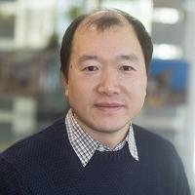
Module Tutor – DR. Young Saeng Park
Young Saeng Park is a Teaching Fellow in WMG
He has more than 20 years of experiences in Software Development using various programming languages, frameworks, platforms and databases.
After having PhD, he worked in the area of automation systems to focus on research and development related to manufacturing digitalisation and Industry 4.0, impacting on and supporting the life cycle of automation in industry.
His interests are: web/application development, manufacturing digitalisation, software development pattens, machine learnings, etc.
Teaching Modules
Software Development Life Cycle
Real-Time Operating Systems
User Experience and Application Development

Slide 3
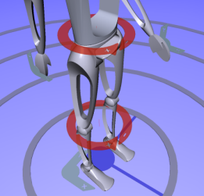
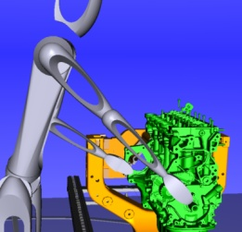
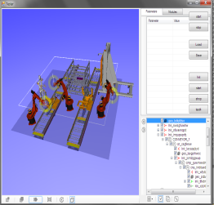
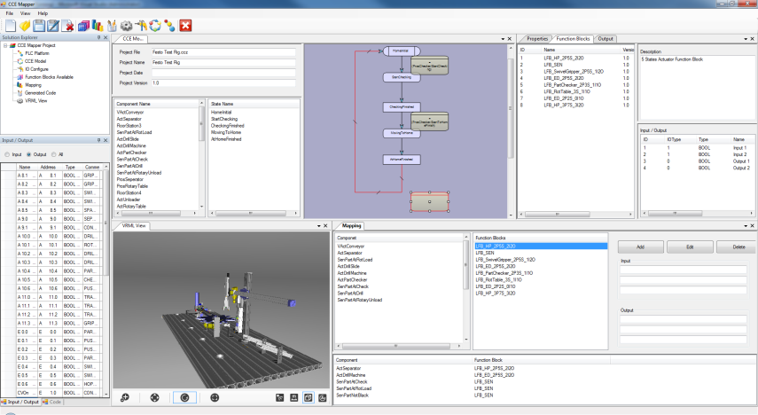
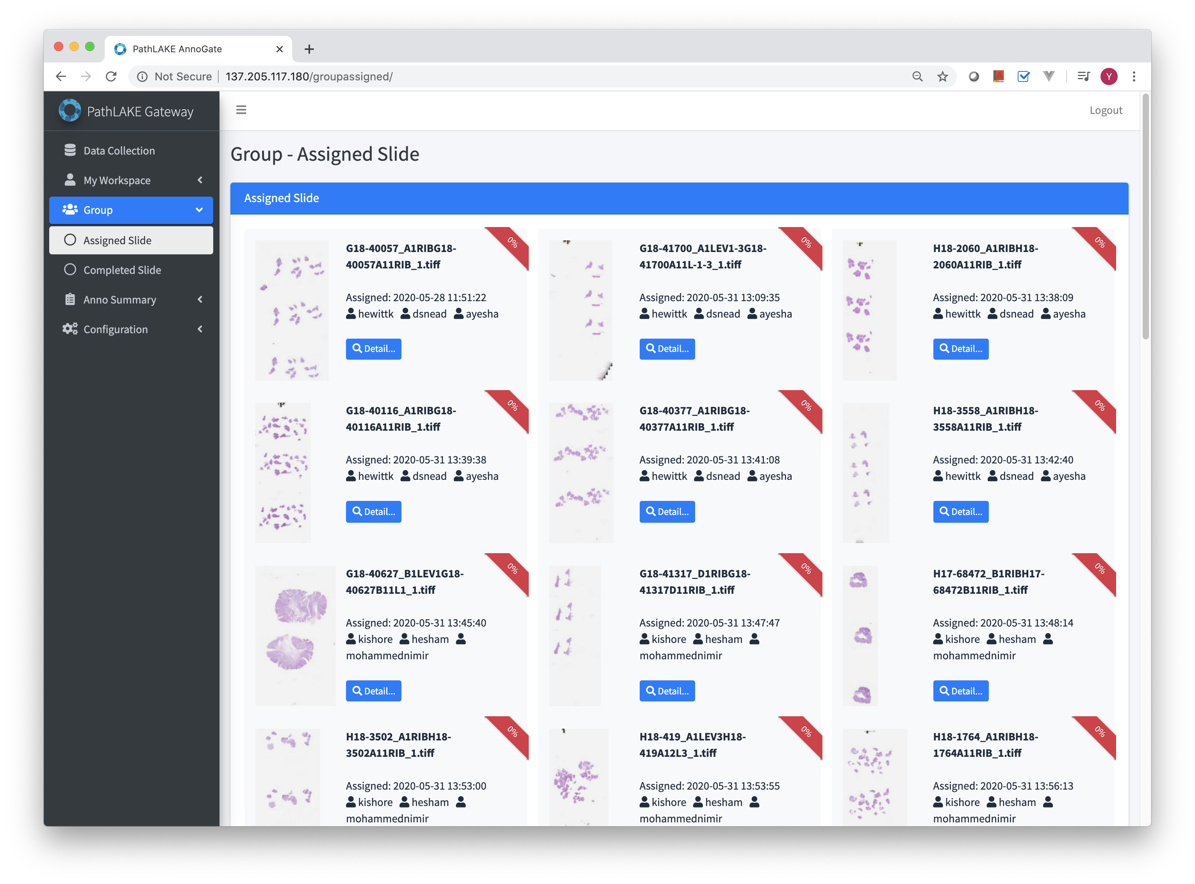
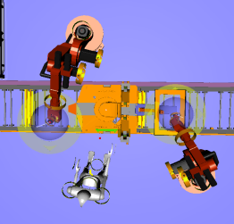
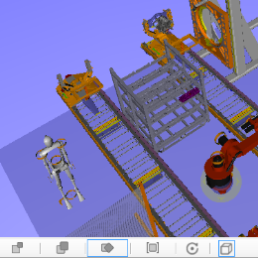
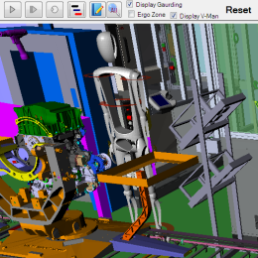
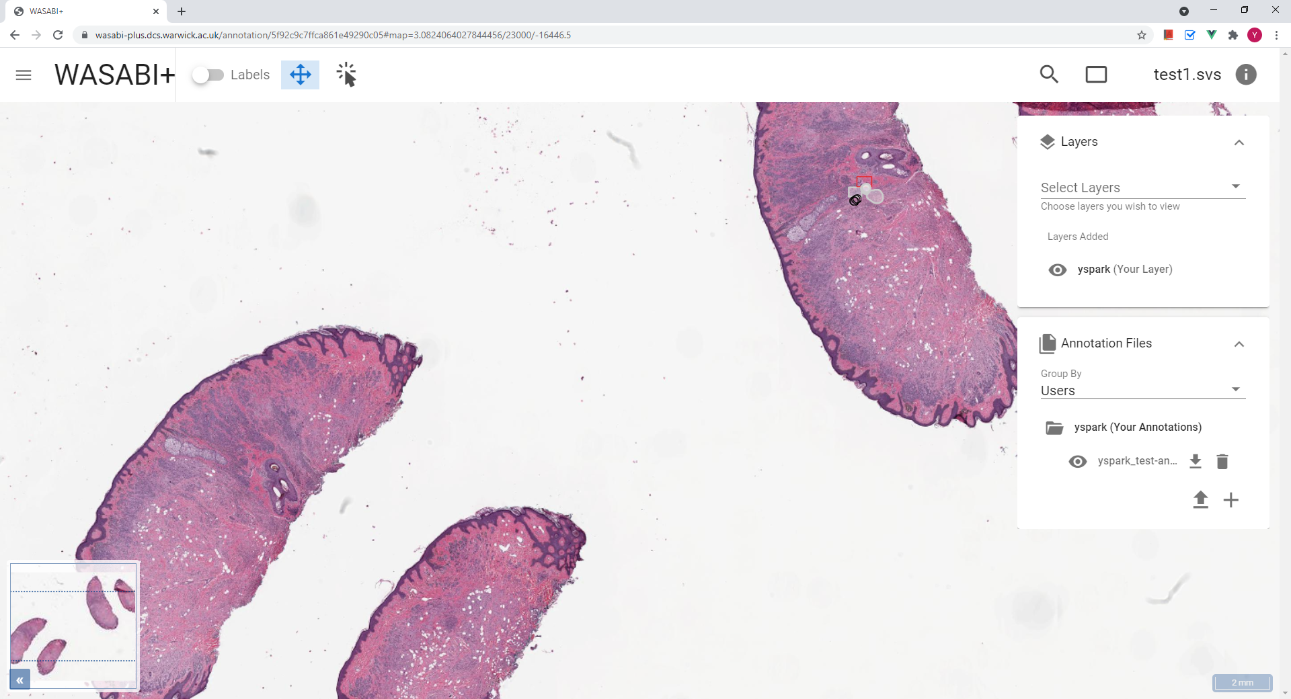
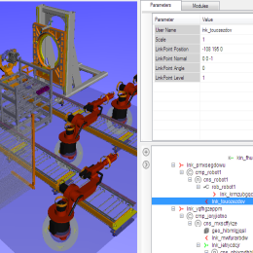
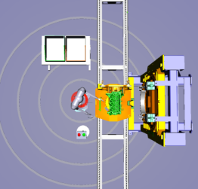

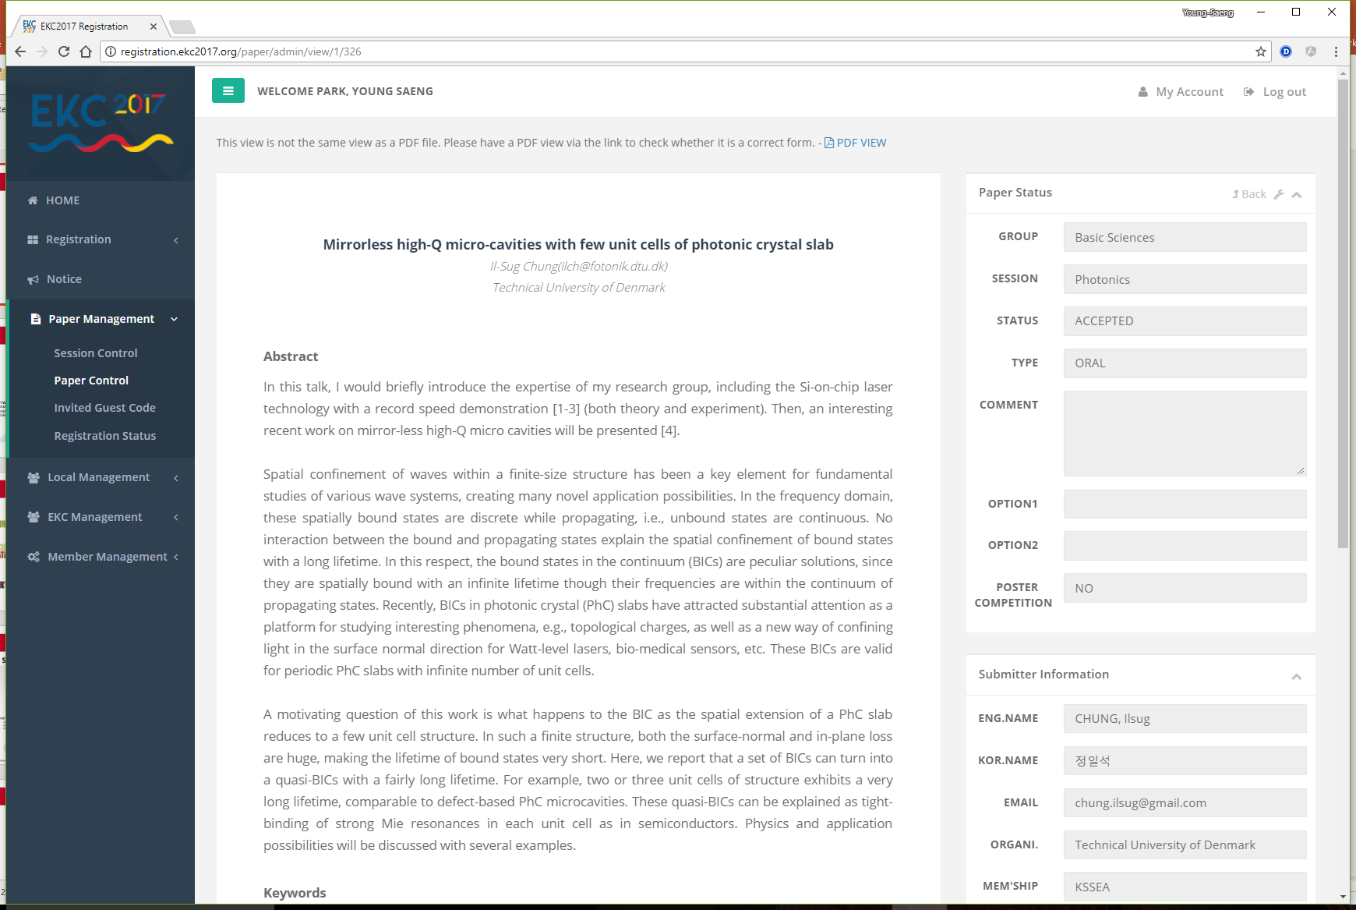
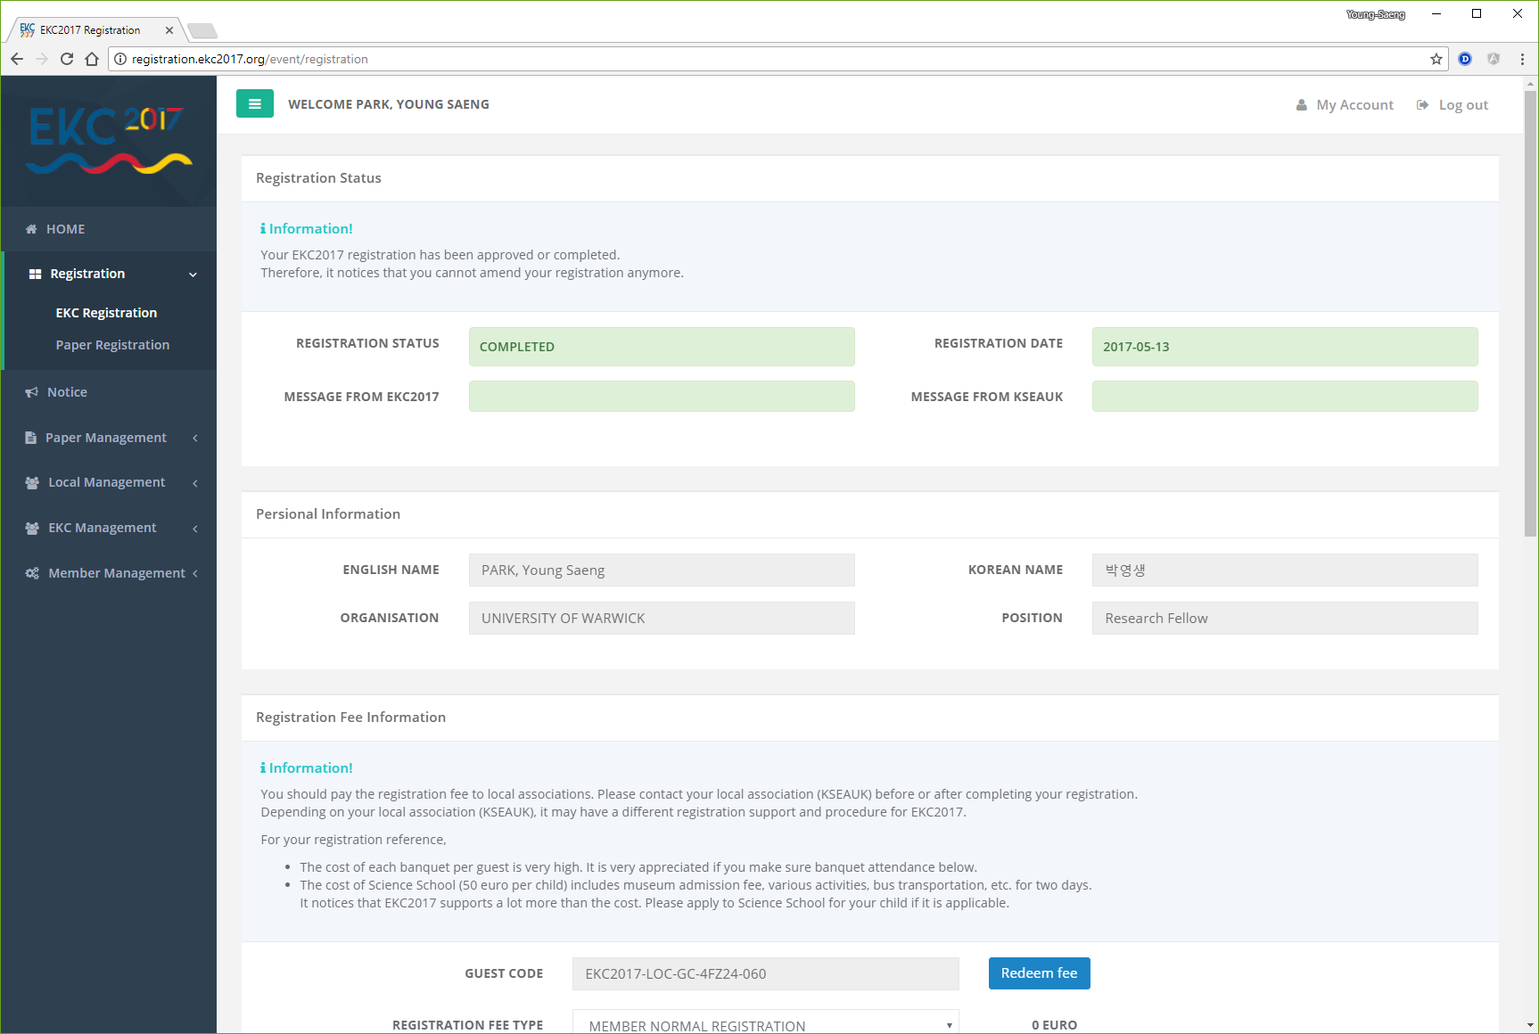
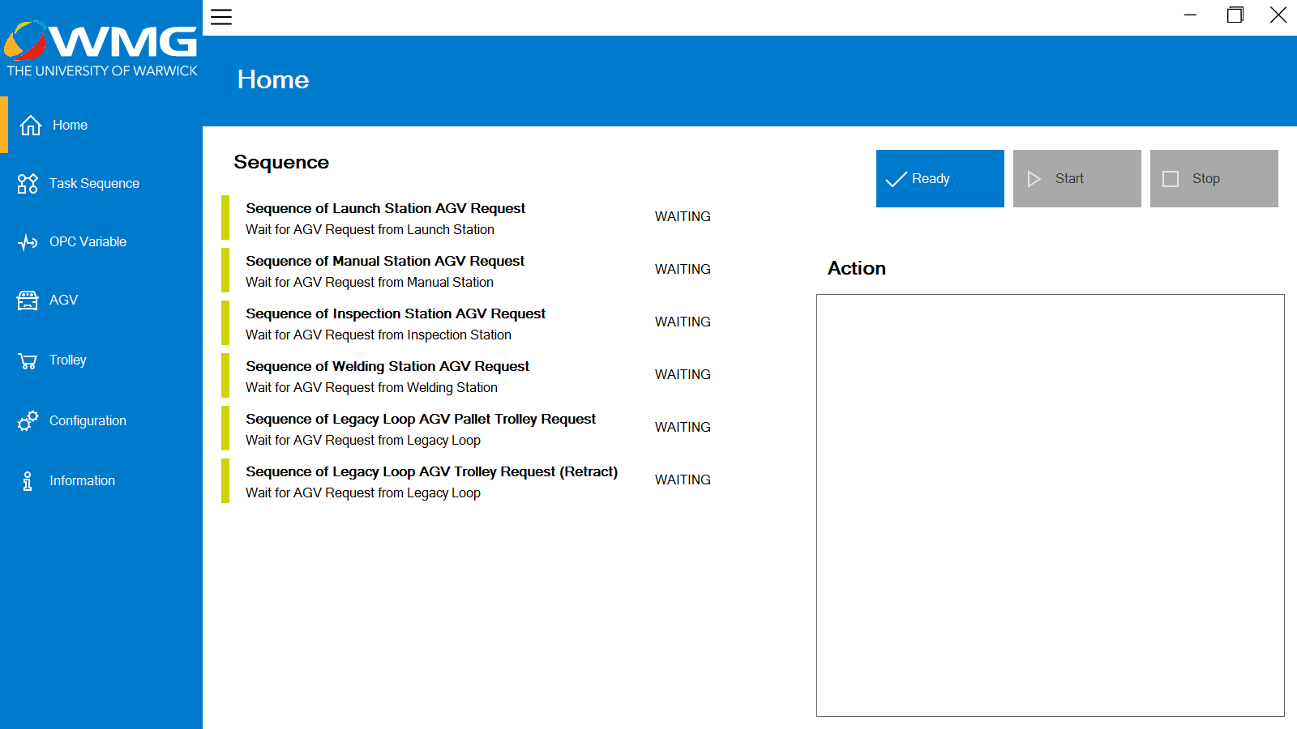
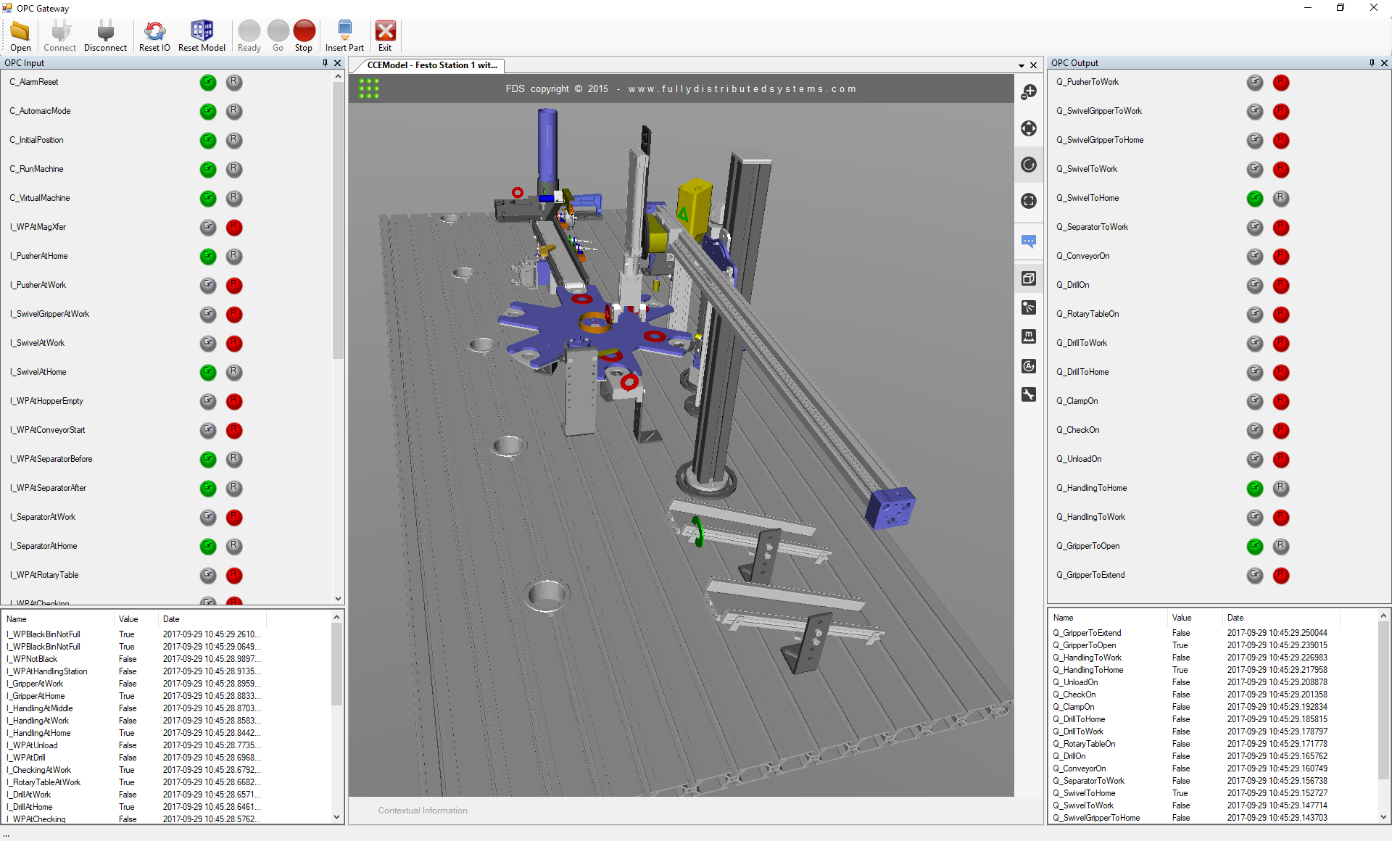

Module Tutor – Some Works
Virtual Engineering Toolset
PLC IO Mapper
Digital Slide Management
Conference Management
Smart Logistic AGV
Virtual Commissioning

Slide 4

Module Knowledge, Skills and Behaviours ( 1 )
How to operate at all stages of the software development life cycle.
How teams work effectively to develop software solutions embracing agile and other development approaches.
How to apply software analysis and design approaches.
How to interpret and implement a design, compliant with functional, non-functional and security requirements.
How to perform functional and unit testing.
How to use and apply the range of software tools used in Software engineering.
Source: Online Learning Consortium

Slide 5

Module Knowledge, Skills and Behaviours ( 2 )
Create effective and secure software solutions using contemporary software development languages to deliver the full range of functional and non-functional requirements using relevant development methodologies.
Undertake analysis and design to create artefacts, such as use cases to produce robust software designs.
Produce high quality code with sound syntax in at least one language following best practices and standards.
Perform code reviews, debugging and refactoring to improve code quality and efficiency.
Test code to ensure that the functional and non-functional requirements have been met.
Deliver software solutions using industry standard build processes, and tools for configuration management, version control and software build, release and deployment.
Source: YWCA Saskatoon

Slide 6

Module Learning Outcomes
LO1: Demonstrate a sound understanding of a range of software process models and symbolic representations.
LO2: Discriminate scenarios where different design patterns and software testing strategies can be applied, and critically evaluate these patterns and testing solutions.
LO3: Apply the range of software tools and techniques used for configuration management, version control and software build.
LO4: Discriminate the key concepts and techniques used in the Agile Manifesto and Scrum, carefully design and critically evaluate project plans using these techniques.
LO5: Distinguish current and emerging agile methods such as XP, Lean, and Kanban values, principles, and practices, use these techniques to analyse and optimize process workflow.
Source: Online Learning Consortium

Slide 7
Software Development Life Cycle
Requirements
Analysis
Design
Implementation
Testing
Maintenance
Cloud Computing
Linux Administration
Container Technology
Version Control
Object Oriented Programming
CI/CD
Amazon Web Service
Shell Script
UML
Web Programming
Unit Testing

Slide 8
Teaching Plan – Block 1
Software and Software Engineering
Requirements
Cloud Computing and AWS
Linux and Shell Script
Process Models and Agile Development
Monday
(13 / 09)
DAY 01
Tuesday
(14 / 09)
DAY 02
Wednesday
(15 / 09)
DAY 03
Thursday
(16 / 09)
DAY 04
Friday
(17 / 09)
DAY 05

Slide 9
Teaching Plan – Block 2
Container Technology
System Modelling
Architecture Design
UML
Monday
(18 / 10)
DAY 06
Tuesday
(19 / 10)
DAY 07
Wednesday
(20 / 10)
DAY 08
Thursday
(21 / 10)
DAY 09

Slide 10
Teaching Plan – Block 3
Version Control
Software Design Patterns
Software Design and Implementation
Object Oriented Programming
Web Development
Monday
(22 / 11)
DAY 10
Tuesday
(23 / 11)
DAY 11
Wednesday
(24 / 11)
DAY 12
Thursday
(25 / 11)
DAY 13
Friday
(26 / 11)
DAY 14

Slide 11
Teaching Plan – Block 4
Debugging
Testing
CI/CD
Software Evolution
Monday
(10 / 01)
DAY 15
Tuesday
(11 / 01)
DAY 16
Wednesday
(12 / 01)
DAY 17
Thursday
(13 / 01)
DAY 18

Slide 12


Session Structure
TIME
SESSION
REMARK
 | 09:00 – 09:50 | Lecture (Main Lecture Channel) | Live Recorded
 | 10:00 – 10:50 | Lecture (Main Lecture Channel) | Live Recorded
 | 11:00 – 11:50 | Team or Individual Activity (Your Team Channel)
 | 12:00 – 12:30 | Review or Tip (Main MS Teams Channel) | Block 1, 3 ONLY

Slide 13

Assessment
1. Team Project ( 40% )
This is a team based assignment.
You belong to a team randomly selected by a tutor to work on the assignment.
Your team should provide a team project report.
The project report mark will equally apply to each member in the team.
2. Individual Project ( 60%)
This is an individual based assignment.
You should provide an individual report and also implement a prototype application.
Your individual project is based on the team project.
Source: Graduate Programs for Educators

Slide 14


What to (NOT) DO
DOs
DON’Ts
Do ask questions via Moodle.
Do practice yourself when you have any practice sessions.
Do explore the world to find any useful resources and information for your understanding.
Do spend more time with your teammates.
Do share good things with others.
Do help each other.
Do make good use of the teaching materials.
Don’t expect other people to ask questions for you.
Don’t expect you to understand everything once and for all.
Don’t blame yourself for not knowing.
Don’t give up anything until you try.
Don’t skip anything because you know.
Don’t spend lots of time searching on the internet.

Slide 15

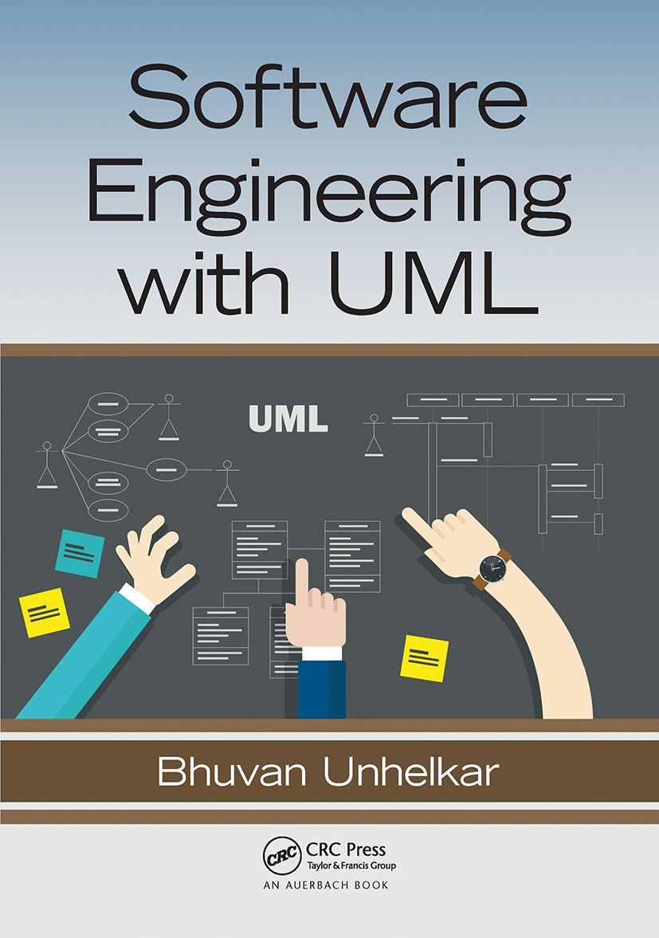



Reference List
Software Engineering
Ian Sommerville
Software Engineering with UML
Bhuvan Unhelkar
The Agile Samuria
Jonathan Rasmusson

Slide 16
THANKS!
Q & A
Any questions?
y.s.park@warwick.ac.uk

